Slide 1
STEGANOGRAPHY
CAPSTONE PROJECT
Presented By:
Student Name : NITYA PRAKASH PATTANAIK
College Name & Department : MBA OPERATIONS, SCHOOL OF MANAGEMENT, NIT ROURKELA

Slide 2
OUTLINE
Problem Statement: Secure Data Hiding in Images Using Steganography
Technology used: Python,
Wow factor: Simple yet Powerful, User-Friendly GUI, Fast and Efficient, Secure Data Concealment
End users: Journalist, , Activists, Law Enforcement, Investigative Reporters, Intelligence Officers
Result: Encrypted Image File, Modified Byte Values, No Visible Changes
Conclusion: The tool provides a simple and secure way to encrypt and decrypt image files using a shared secret key.
Git-hub Link: https://github.com/Nityaprakash21/Steganography
Future scope: Multi-File Encryption, Advanced Algorithms, Cloud Storage Integration

Slide 3
Problem Statement
Secure data hiding in images using steganography is the process of embedding confidential information within digital images to ensure privacy, integrity, and authenticity. This technique leverages encryption and steganographic algorithms to conceal data within image pixels, making it undetectable to unauthorized users. It plays a crucial role in secure communication across networks, ensuring sensitive information remains protected during transmission. Applications include journalism, law enforcement, intelligence, and cybersecurity, offering benefits such as confidentiality, integrity, authenticity, and compliance with security protocols.

Slide 4
Technology used
PYTHON: Programming language

Slide 5
Wow factors
Simple yet Powerful, User-Friendly GUI, Fast and Efficient, Secure Data ConcealmentThe Python-based steganography tool is a comprehensive solution that seamlessly combines simplicity, power, and security. With its intuitive and user-friendly GUI, the tool enables users to easily hide and retrieve data within image files. Its advanced steganographic algorithms ensure fast and efficient processing while maintaining the original image quality. Additionally, the tool prioritizes secure data concealment, leveraging encryption techniques to protect sensitive information from unauthorized access. This ensures confidentiality, integrity, and authenticity, making it an ideal solution for individuals and organizations seeking a reliable and efficient way to embed secret data within images

Slide 6
End users
Journalists, Activists, Law Enforcement, Investigative Reporters, Intelligence OfficersThese professionals are key stakeholders who can benefit from the Python-based steganography tool. Journalists and investigative reporters can use it to discreetly embed sensitive information within images, ensuring secure transmission and protecting their sources. Activists can leverage the tool to safeguard critical communications, preventing unauthorized interception. Law enforcement agencies can securely exchange classified images and evidence, maintaining the integrity of investigations. Intelligence officers can employ the tool to conceal sensitive data within images, enhancing operational security. With its advanced encryption and privacy-preserving protocols, this tool serves as an essential resource for individuals handling confidential information, enabling them to operate with enhanced security and anonymity.

Slide 7
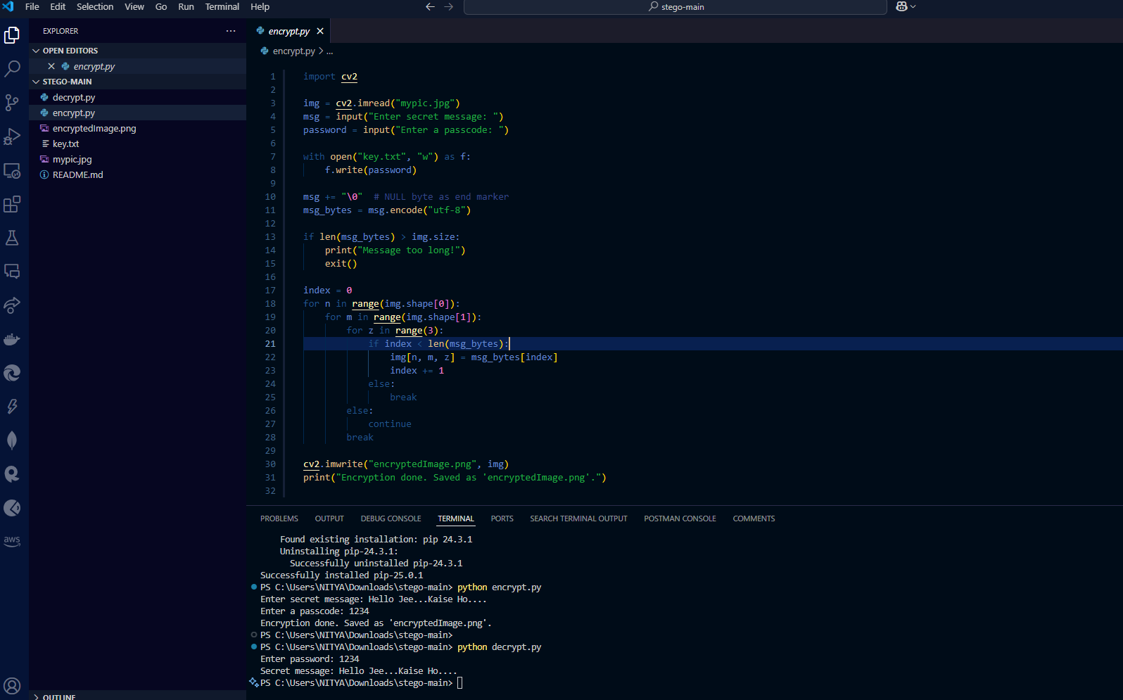
Results

Slide 8
Conclusion
The Tool Provides a Simple and Secure Way to Encrypt and Decrypt Image Files Using a Shared Secret Key
This offers a straightforward and secure method for encrypting and decrypting image files using a shared secret key. By utilizing a simple and intuitive interface, users can easily select an image file, enter a shared secret key, and encrypt or decrypt the file with just a few clicks. The tool employs a robust encryption algorithm that ensures the confidentiality and integrity of the image data, making it virtually impossible for unauthorized parties to access or manipulate the encrypted files. Furthermore, the tool's use of a shared secret key provides an additional layer of security, as only individuals with knowledge of the key can decrypt and access the encrypted image files. Overall, the tool's simplicity, security, and ease of use make it an ideal solution for individuals and organizations seeking to protect sensitive image data.

Slide 9
GitHub Link
GITHUB LINK
https://github.com/Nityaprakash21/Steganography

Slide 10
Future scope(optional)
Multi-File Encryption, Advanced Algorithms, Cloud Storage Integration, Mobile App Development
The future development of the operation tool is poised to introduce several exciting features that will further enhance its functionality and user experience. One of the key upcoming features is multi-file encryption, which will enable users to encrypt and decrypt multiple image files simultaneously, saving time and increasing productivity. Additionally, the tool will incorporate advanced encryption algorithms, such as quantum-resistant cryptography, to provide even stronger security and protection for sensitive image data. Furthermore, the tool will be integrated with popular cloud storage services, allowing users to seamlessly upload and store their encrypted image files in the cloud. Finally, a mobile app version of the tool will be developed, enabling users to encrypt and decrypt image files on-the-go, using their smartphones or tablets, and providing an additional layer of convenience and flexibility.

Slide 11
THANK YOU

